Slide 1
Deep Supermarket Transfer Learning Approach for Classification of Indian Supermarket Products
Reg No: 20BCE1506
Name: Varun Verma
Guide: Dr. Noel Jeygar Robert V

Slide 2
Outline
Introduction
Literature Review
Themes Discovered
Gaps Identified
Research
Challenges Addressed
Objectives of paper
Problem Statement
Methodology Diagram
Data Collection Methods
Proposed System Diagram
Implementations
Dataset Stats
Class Distributions
Models
CNN (Custom Model)
EfficientNetB7 (TL)
Results
Findings & Interpretations
Implementations (100%)
Dataset Stats
Class Distributions
Class Balancing
Models
CNN (Traditional Approach)
VGG19 (Traditional Approach)
EfficientNetB7 (TL + Custom)
InceptionResNetV2 (TL)
DenseNet169 (TL)
DenseNet201 (TL)
Results
Model Stats
Comparative Results
Findings & Discussions
Conclusion
Future Work
Research Paper Status
Poster

Slide 3
Introduction
This research aims to “develop an advanced image classification model for supermarket products, leveraging DNN algorithms and to evaluate performance in product categorization of modern Indian retail”.
Background of the problem
The growing need for intelligent technologies for autonomous product categorization in retail settings, particularly in automated retail storage and self checkout terminals, necessitates the development of specialized product classifiers.
Domain of Study
This research is situated within the context of AI (DNN) applications for automated retail in India.

Slide 4
Significance of Study lies in its dual contributions
Firstly, the creation of a custom dataset for Indian supermarket products addresses the current absence of datasets catering to this domain.
Secondly, the exploration and comparison of deep learning models (CNN, InceptionResNet, EfficientNet)
The study aims to offers insights into the most effective classifier and algorithm for Indian retail environments.
Expected Outcomes:
Identification of Optimal Model for image classification of Indian supermarket products
Construct a specialized dataset that fills the void in existing resources for Indian supermarket product classification.
Provide practical insights for the development and implementation of automated systems in superstores, aligning with the evolving trend towards minimal human interaction.
Journal Publication

Slide 5
Literature Review
S no. | Research Paper Title | Techniques Used | Pros | Cons
[0] | Store product classification using CNN | Convolutional Neural Network (CNN) | Efficient product sorting, high accuracy (91.37%) | Dependency on preprocessed image size (256x256 pixels). Trained on small dataset
[1] | Convolutional Neural Network (CNN) of Resnet-50 with Inceptionv3 Architecture in Classification on X-Ray Image | CNN, Resnet-50, Inceptionv3 | Effective for COVID-19 detection (99% accuracy), Optimized hyperparameters, Comprehensive study | Computation time (6h for Inceptionv3, 9h 21min for Resnet-50)
[2] | An effective CNN and Transformer complementary network for medical image segmentation | CNN - Transformer Complementary Network (CTC-Net) | Superior performance in medical image segmentation (multi-organ, cardiac) | Complexity due to multiple components, Potential overfitting
[3] | Comparison of CNN-based deep learning architectures for rice diseases classification | DenseNet121, Inceptionv3, Resnet152V, InceptionResNetV2, Transfer learning | High accuracy (98%), Effective in plant disease detection, Comparison of multiple architectures | Limited discussion on specific diseases, Dataset specificity

Slide 6
S no. | Research Paper Title | Techniques Used | Pros | Cons
[4] | Deep Learning Model Based on ResNet-50 for Beef Quality Classification | ResNet-50, Generative Adversarial Network (GAN) | Accuracy of 96.03% in training, 91.67% in testing, 88.89% in validation, Efficient in beef quality classification | Limited dataset size, Dependency on GAN for image augmentation, Texture analysis challenges
[5] | Performance evaluation of ResNet model for classification of tomato plant disease | ResNet-50, ResNet-18, TL | High accuracy (96.35% for ResNet-50), Time efficiency (ResNet-18) | Limited dataset for testing, No actual tomato leaves collected
[6] | An Enhanced Transfer Learning Based Classification for Diagnosis of Skin Cancer | Deep Learning with Transfer Learning (Enhanced VGG16) | High accuracy (89.09%) in identifying benign and malignant skin cancer stages | Requires a considerable amount of computational resources and training time
[7] | A Study of CNN and Transfer Learning in Medical Imaging: Advantages, Challenges, Future Scope | CNN, Transfer Learning, Residual CNN | Improved accuracy, Reduced time and resource requirements | Limited interpretability of deep learning models, Need for large and diverse datasets
[8] | Classification of benign and malignant subtypes of breast cancer histopathology imaging using hybrid CNN-LSTM based transfer learning | Transfer Learning, CNN+LSTM RNN | High overall accuracy (99% for binary, 92.5% for multi-class), Transfer learning success | Limited interpretability of deep learning models
[9] | Fusion of U-Net and CNN model for segmentation and classification of skin lesion from dermoscopy images | U-Net, CNN Fusion Model (U-Net + CNN) Adam and Adadelta optimizers | Quick and precise identification of skin lesions | Limited insight into model structure

Slide 7
S no. | Research Paper Title | Techniques Used | Pros | Cons
[10] | Product Classification in E-Commerce Sites | Supervised Learning, ML Models, (Decision Trees, SVM, Random Forest, Logistic Regression, Naive Bayes) | Logistic Regression achieved high accuracy (91.55%), Accurate classification | Dependency on labeled training data, Overfitting with insufficient data
[11] | Machine Learning-Based Autonomous Framework for Product Classification Over Cloud | Optimized Multiclass Logistic Regression (O-MLR) implemented over Microsoft Azure Cloud | Utilizes cloud computing for scalable processing of massive datasets (Big Data) | Dependency on cloud infrastructure
[12] | Deep Learning Approach to Recyclable Products Classification: Towards Sustainable Waste Management | CNN, DenseNet169, MobileNetV2, ResNet50V2 | High accuracy, Contribution to automating garbage classification, Potential for sustainable waste management | Limited insight into model structure, Limited discussion on challenges and limitations
[13] | Convolutional Neural Network (CNN) Based Identification of Crop Diseases Using ResNet-50 | CNN, ResNet-50, Adam Optimizer | High accuracy (99.02%) Using ResNet-50 | Limited discussion on model transparency, Specific to crop disease identification
[14] | Breast lesion classification using features fusion and selection of ensemble ResNet method | ResNet CNN architectures (ALL-ResNet, Fused ResNet) Feature selection (MR-MR, NCA) | Successful feature selection, Novel fused ResNet architecture | Limited insight into feature selection techniques, Specific to breast lesion classification
[15] | Fabric defect detection and classification using modified VGG network | Pseudo–Convolutional Neural Network (P-CNN), Modified CNN | Early detection of fabric defects, High accuracy for fabric types, Automated fabric quality inspection | Limited details on Modification for making P-CNN and no details on VGG network

Slide 8
Themes Discovered:
The literature for image classification, emphasizing the use of deep neural network models like CNN, ResNet50, and InceptionV3, etc. because of their superior performance in diverse image classification tasks
Strategies involve combinations of CNN with other models or the use of pre-trained weighted models (Transfer learning) are explored to optimize deep learning architectures. (TL over Ensemble)
Gaps Identified:
A significant gap is identified in the literature regarding grocery product classification, specifically within the context of Indian products.
The lack of datasets for Indian product classification underscores a critical gap in understanding the unique characteristics of the Indian market products.

Slide 9
Research Challenges
Challenges Addressed:
Absence of Specialized Dataset:
No existing dataset aligns with the specific requirements of classifying Indian supermarket products.
Lack of Indian Market-Specific Image Classifier:
Current image classification models do not cater to the diverse range of products found in Indian superstores.
Need for Automated Product Categorization:
In the context of future retail stores with minimal human interaction, there's a pressing need for intelligent systems capable of autonomously categorizing products.

Slide 10
Research Objectives
Custom Dataset Creation:
Develop a comprehensive dataset featuring a diverse array of Indian supermarket products and their categories.
Model Development and Comparison:
Construct multiple image classification models, incorporating advanced algorithms like CNN, VGGNet, ResNet50 , InceptionV3.
Performance Evaluation:
Evaluate and compare the performance of each model in accurately categorizing Indian supermarket products.
Fine-Tuning for Indian Market Context:
Optimize the models to effectively handle the unique characteristics and challenges presented by Indian market products.
Enhancement of Model Performance:
Investigate techniques to further enhance the accuracy and efficiency of the classification models.

Slide 11
Problem Statement
The research aims to develop a robust and advanced product classification system tailored for Indian supermarkets, leveraging deep learning.
The primary focus involves utilizing Convolutional Neural Networks (CNN) as a base classifier and enhancing its performance through state-of-the-art Deep Neural Networks (DNN) using Transfer Learning approach (DenseNet, EfficientNet, etc).
A distinctive contribution of this study is the creation of a custom dataset specifically designed for the classification of Indian supermarket products. The dataset encompasses a diverse range of items commonly found in Indian supermarkets, ensuring a comprehensive representation of the unique characteristics and variations in the products.
Currently, no such dataset, classifier or research paper addressing the classification of Indian supermarket products is available, highlighting the novelty and significance of this research.

Slide 12
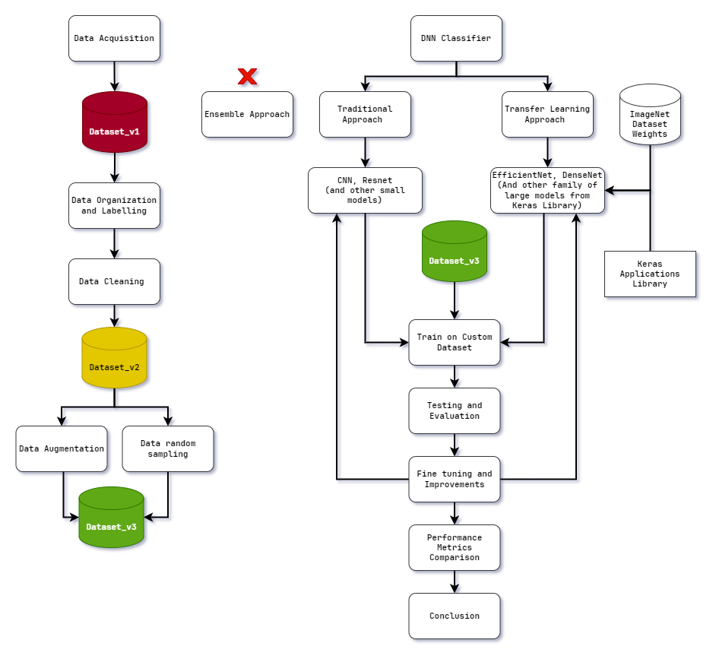
Methodology

Slide 13
Data Collection Strategy :
Custom Dataset Creation using Bing Image Downloader and Google Colab:
Advantage: Automated and scalable image collection using Python's Bing Image Downloader and Google Colab.
Limitation: Dependency on search engine results may lead to variations in image quality and relevance; efforts will be made to filter and refine the collected images.
Potential Risks: Inconsistencies in data quality may arise; rigorous preprocessing will be employed to maintain dataset integrity. Class imbalance is likely
Ethical Considerations:
Adhering to copyright and usage rights for downloaded images to avoid legal issues. Ensuring that image downloads comply with the terms of service of the search engine and respecting copyright and usage rights.

Slide 14
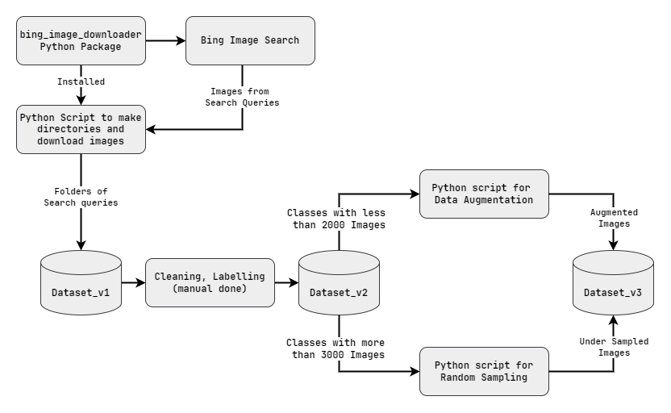
Proposed System

Slide 15
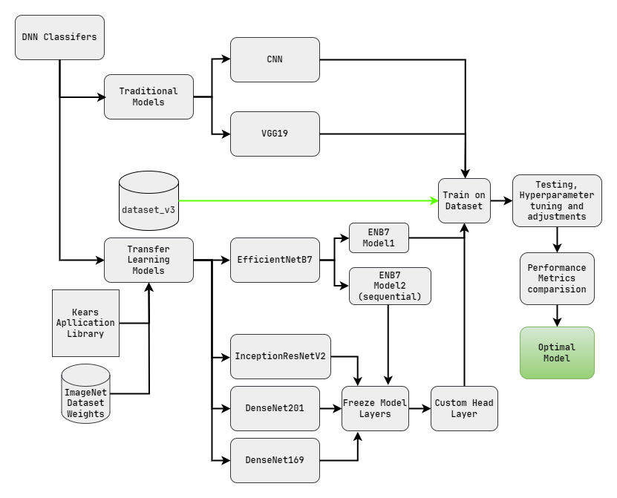
Proposed System

Slide 16
Implementations
Implemented :
Dataset_v1 (25K samples)
Dataset_v1 Cleaning, Organization and Labelling → Dataset_v2 (22K samples)
Dataset_v2 Augmentation and Random Sampling → Dataset_v3 (35K samples)
CNN (Traditional Approach)
VGG19 (Traditional Approach)
EfficientNetB7 (TL + Custom)
InceptionResNetV2 (TL)
DenseNet169 (TL)
DenseNet201 (TL)

Slide 17
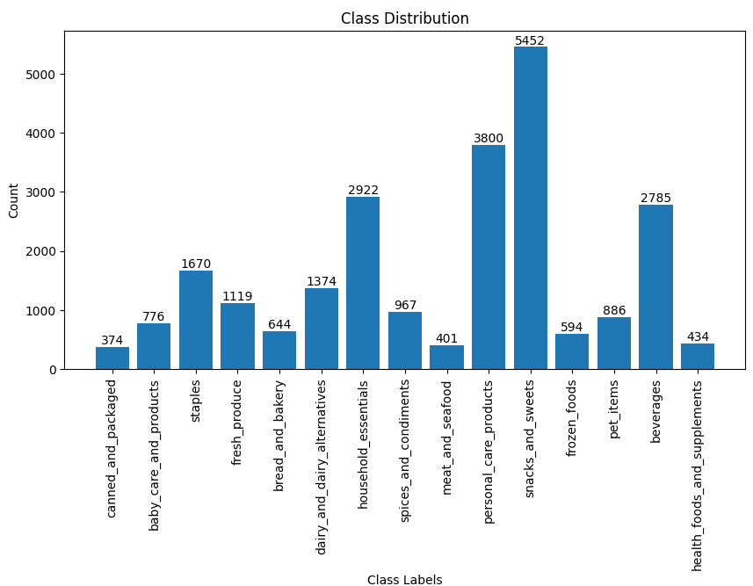
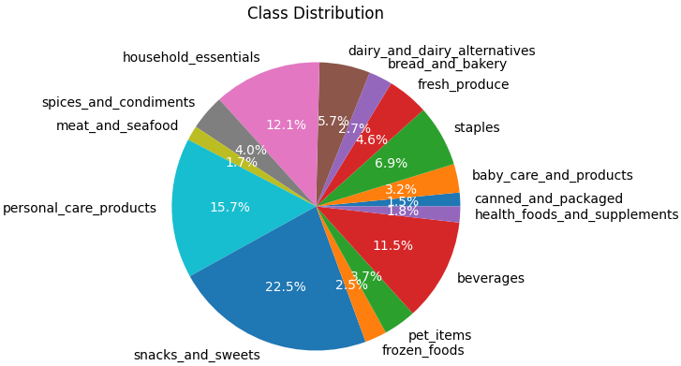
Dataset Class Distributions
Initially, dataset_v1 was created which contained the raw image data.
It underwent cleaning and organization which resulted in the creation of dataset_v2
However dataset_v2 although was cleaned and organized, suffered from major class imbalance

Slide 18
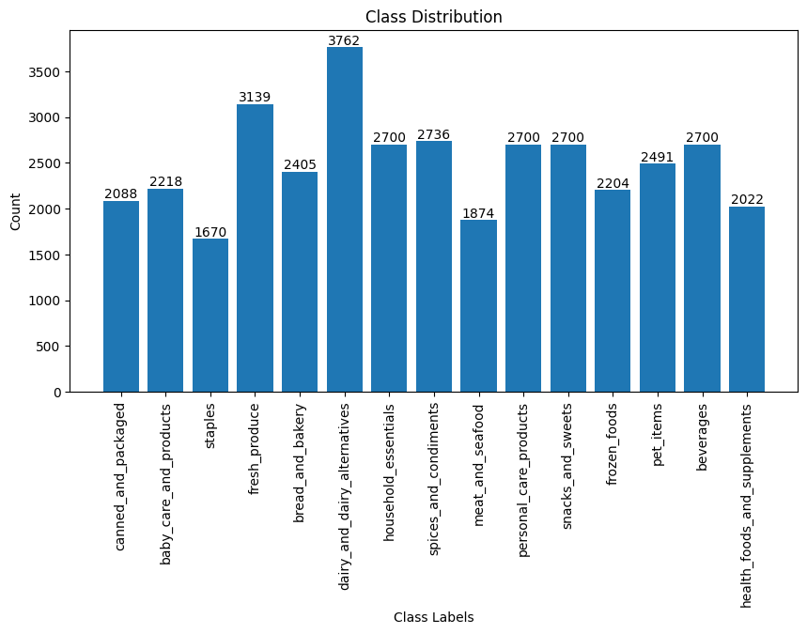
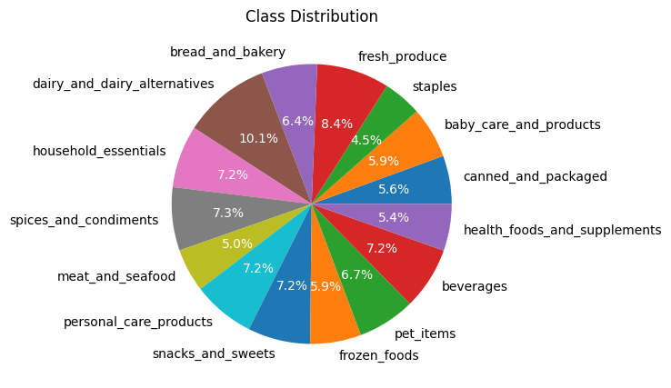
Class Balancing
To address this imbalance, dataset_v3 was created using:
Data augmentation techniques (for classes with fewer images)
Random under sampling (for classes with excessive images)

Slide 19
Model Summary
CNN ARCHITECTURE
VGG19 ARCHITECTURE
Input Layer: 256x256 RGB image data.
Convolutional Blocks:
Four blocks with increasing filter sizes.
3. Flatten Layer: Converts output to a 1D vector.
4. Fully Connected Block:
Two dense layers, with dropout, producing 15- class probabilities.
Input Layer: 256x256 RGB image data.
Convolutional Blocks:
Four blocks with increasing filter sizes:
Block 1: Two conv layers with 64 filters.
Block 2: Two conv layers with 128 filters.
Block 3: Four conv layers with 256 filters.
Block 4: Four conv layers with 512 filters.
Block 5: Four conv layers with 512 filters.
Flatten Layer: Converts output to a 1D vector.
Fully Connected Block:
Two dense layers with 4096 neurons each, followed by ReLU activation.
Dropout layers after each fully connected layer with a rate of 0.5.
Final Layer: Dense layer with 15 neurons for classification task, using softmax activation to produce class probabilities.

Slide 20
Model Summary
ENB7 MODEL1 ARCHITECTURE
ENB7 MODEL2 ARCHITECTURE
Base Model Initialization:
Initializes the EfficientNetB7 model from Keras applications library.
Excludes top (classification) layers for customization.
Loads pre-trained weights from ImageNet dataset.
Specifies input shape as 256x256 pixels with 3 color channels.
Applies global average pooling to reduce spatial dimensions.
Custom Model Construction:
Constructs a sequential model using Keras library.
Adds EfficientNetB7 base model as the first layer, set to non-trainable.
Adds a flatten layer to convert output into a 1D vector.
Adds a dense layer with 15 neurons and softmax activation for output.
Model Compilation:
Compiles the model with Adam optimizer.
Uses categorical cross-entropy loss for multi-class classification.
Evaluates accuracy as the performance metric during training.
Pre-trained EfficientNetB7 Base Model:
Loads pre-trained EfficientNetB7 model from Keras applications library.
Excludes top layers for customization.
Uses ImageNet weights for feature extraction.
Specifies input shape as 256x256 pixels with 3 color channels.
Applies global average pooling for dimension reduction.
Custom Sequential Model:
Constructs a sequential model using Keras.
Integrates EfficientNetB7 as the first layer, set to non-trainable.
Adds a flatten layer for 1D output.
Includes two dense layers with ReLU activation and L2 regularization.
Dropout layers (50% dropout rate) to prevent overfitting.
Final dense output layer with softmax activation for class probabilities.
Model Compilation:
Compiles with Adam optimizer (custom learning rate).
Uses categorical cross-entropy loss for multi-class classification.
Evaluates accuracy during training.
Fine-Tuning:
Unfreezes last 20 layers for fine-tuning.
Excludes batch normalization layers from fine-tuning to maintain stability.

Slide 21
Model Summary
INCEPTIONRESNETV2 ARCHITECTURE
DENSENET169 ARCHITECTURE
Base Model Initialization:
Loads InceptionResNetV2 model with pre-trained weights from Keras Applications library.
Excludes fully connected layers for customization.
Initializes with ImageNet weights.
Specifies input shape as 256x256 pixels with 3 color channels.
Freezing Base Model Layers: Sets all base model layers to non-trainable to preserve weights during training.
Custom Head Creation:
Defines custom head layers to be added on top of the base model.
Applies global average pooling to reduce spatial dimensions.
Adds a dense layer with 1024 neurons and ReLU activation for feature transformation.
Includes a dense output layer with softmax activation for class probabilities.
Connecting Base Model with Custom Head:
Connects base model's input with custom head's output to form the final model architecture.
Model Compilation:
Compiles the model with Adam optimizer (learning rate: 0.001).
Utilizes categorical cross-entropy loss for multi-class classification.
Evaluates accuracy for monitoring model performance during training.
Base Model Initialization:
Initializes DenseNet169 model with pre-trained ImageNet weights.
Excludes top layers, preserving only the convolutional base.
Specifies input shape for expected image dimensions.
Frozen Base Model Layers: Freezes loaded base model layers to retain learned features from ImageNet.
Custom Head:
Adds a custom head for task-specific classification.
Applies global average pooling to aggregate spatial information.
Adds a fully connected dense layer with 1024 units and ReLU activation.
Includes a dense output layer with 15 units and softmax activation for class probabilities.
Model Compilation:
Compiles with Adam optimizer (learning rate: 0.001).
Uses categorical cross-entropy loss for measuring prediction deviation.
Monitors model performance with accuracy metric.

Slide 22
Model Summary
DENSENET201 ARCHITECTURE
Base Model Initialization:
Initializes DenseNet201 model with pre-trained ImageNet weights.
Excludes top layers, keeping only the convolutional base.
Specifies input shape for expected image dimensions (256x256 pixels with 3 channels).
Frozen Base Model Layers: Freezes loaded base model layers to retain learned features from ImageNet.
Custom Head:
Adds a custom head for task-specific classification.
Applies global average pooling to collapse spatial dimensions into a single vector.
Adds a fully connected dense layer with 1024 units and ReLU activation.
Includes a dense output layer with 15 units and softmax activation for class probabilities.
Model Compilation:
Compiles with Adam optimizer (learning rate: 0.001).
Utilizes categorical cross-entropy loss for measuring prediction deviation.
Evaluates performance with accuracy metric during training and validation.

Slide 23
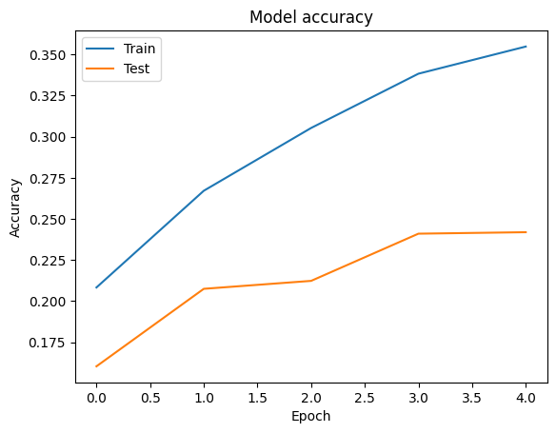
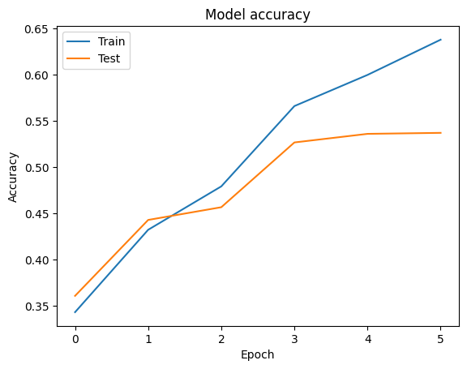
Results
CNN (Traditional)
VGG19 (Traditional)
S no. | Category | Score
1 | Training Accuracy | 35.48 %
2 | Testing Accuracy | 24.19 %
1 | Training Loss | 2.1162
2 | Testing Loss | 4.3453
S no. | Category | Score
1 | Training Accuracy | 63.81 %
2 | Testing Accuracy | 53.73 %
1 | Training Loss | 1.0536
2 | Testing Loss | 2541.41

Slide 24
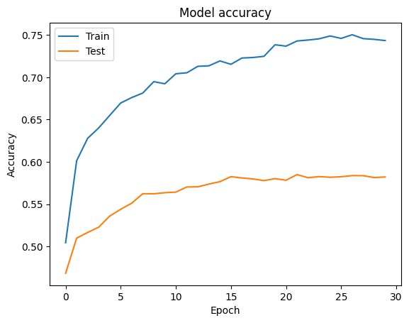
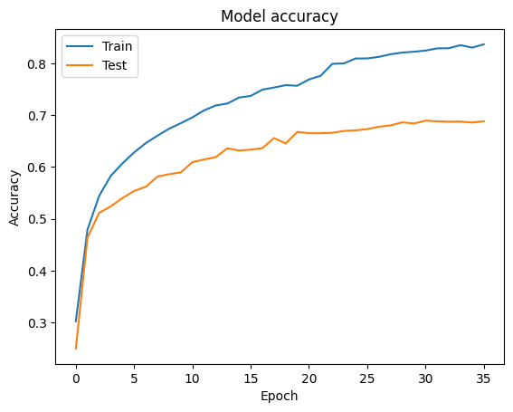
Results
ENB7 - MODEL1 (TL – frozen weights)
ENB7 - MODEL2 (TL – Custom + unfrozen weights)
S no. | Category | Score
1 | Training Accuracy | 74.33 %
2 | Testing Accuracy | 58.22 %
1 | Training Loss | 0.7959
2 | Testing Loss | 1.3884
S no. | Category | Score
1 | Training Accuracy | 83.69 %
2 | Testing Accuracy | 68.95 %
1 | Training Loss | 0.9056
2 | Testing Loss | 1.4071

Slide 25
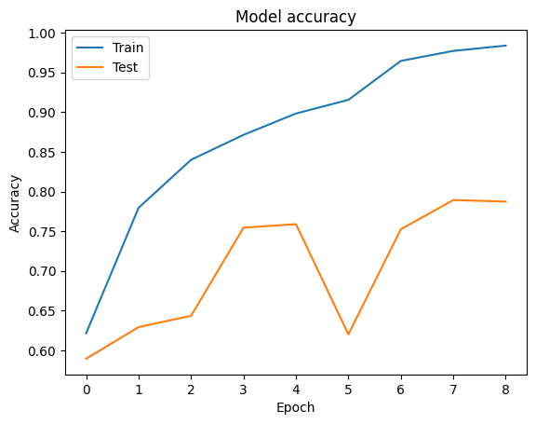
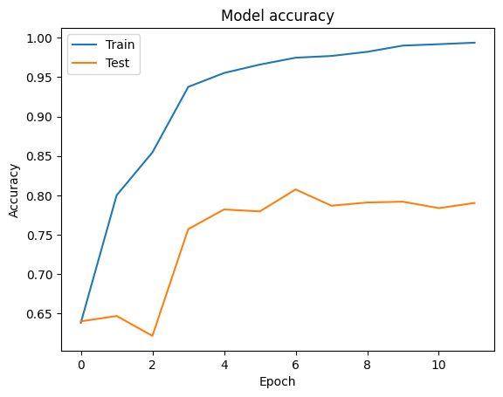
Results
DENSENET169 (TL – Custom + frozen weights)
DenseNet201 (TL – Custom + unfrozen weights)
S no. | Category | Score
1 | Training Accuracy | 98.31 %
2 | Testing Accuracy | 78.73 %
1 | Training Loss | 0.0502
2 | Testing Loss | 0.8535
S no. | Category | Score
1 | Training Accuracy | 99.36 %
2 | Testing Accuracy | 80.47 %
3 | Training Loss | 0.0229
4 | Testing Loss | 0.7684

Slide 26
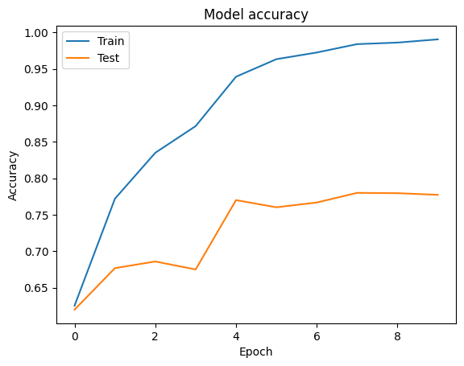
Results
INCEPTIONRESNETV2 (TL – Custom + unfrozen)
S no. | Category | Score
1 | Training Accuracy | 99.04 %
2 | Testing Accuracy | 77.74 %
1 | Training Loss | 0.0326
2 | Testing Loss | 0.9767

Slide 27
Comparative Results
MODEL NAME | TRAINING ACCURACY (%) | TESTING ACCURACY (%) | TRAINING LOSS | TESTING LOSS
Custom CNN | 35.48 | 24.19 | 2.1162 | 4.3453
VGG19 | 63.80 | 53.73 | 1.0536 | 1.4071
ENB7 Model1 | 74.33 | 58.22 | 0.7959 | 1.3884
ENB7 Model2 | 83.69 | 68.95 | 0.9056 | 1.4071
InceptionResNetV2 | 99.04 | 77.74 | 0.0326 | 0.9767
DenseNet169 | 98.31 | 78.73 | 0.0502 | 0.8535
DenseNet201 | 99.36 | 80.47 | 0.0229 | 0.7684

Slide 28
Comparative Results
Training Accuracies of Models
Testing Accuracies of Models

Slide 29
Comparative Results
Training Loss of Models
Testing Loss of Models

Slide 30
Findings & Discussions
This research showed the efficacy of various DNN models in the classification of Indian supermarket products on the custom dataset.
The traditional models, custom CNN and VGG19 architectures faced major difficulties. Despite efforts to address these issues, the performance remained suboptimal.
The Transfer Learning Models (EfficientNet, DenseNet, InceptionResNetV2) architectures had much better performance as compared to the traditional approaches.
The study yielded the following results:
Creation of a new unique dataset - “Indian Grocery Image dataset_v3” (37K images) containing categorized, labelled images of Indian supermarket/grocery products.
The Performance of different models varied greatly depending on the architectures and approaches used, as seen before.
Traditional models have difficulty when generalization
Transfer Learning models showed exceptional performance given by the increase in accuracy and decrease in loss for both testing and training scores.

Slide 31
Conclusion
The CNN and VGG19 traditional models
training and testing accuracies were quite low implying difficulty generalizing to new and complex data.
The EfficientNetB7 architecture
outperformed traditional architectures.
Both Model1 and Model2 of EfficientNetB7 had better training and testing accuracies
Model 2 was outperformed Model 1 in all parameters.
Additional, have the lowest difference of train and test values meaning they offer the best generalization potential among all models.
InceptionResNetV2, DenseNet169, and DenseNet201(TL)
the most accurate models as compared to other architectures implemented.
showed good performance in terms of training accuracy as well as testing accuracy.
Effectively generalize to new data due to low values for testing loss making them optimal for this research’s problem statement.
Among these Transfer Learning architectures, DenseNet201 performed best relative to any other model.

Slide 32
Future Work
More data augmentation techniques and dataset balancing strategies.
May be necessary to consider other deep neural network architecture models.
Comprehensive hyperparameter tuning experiments and ensemble learning methods
Furthermore, these findings indicate the need for the development of domain-specific architectures and datasets for Indian supermarket product images for the practical application of such models in future.

Slide 33
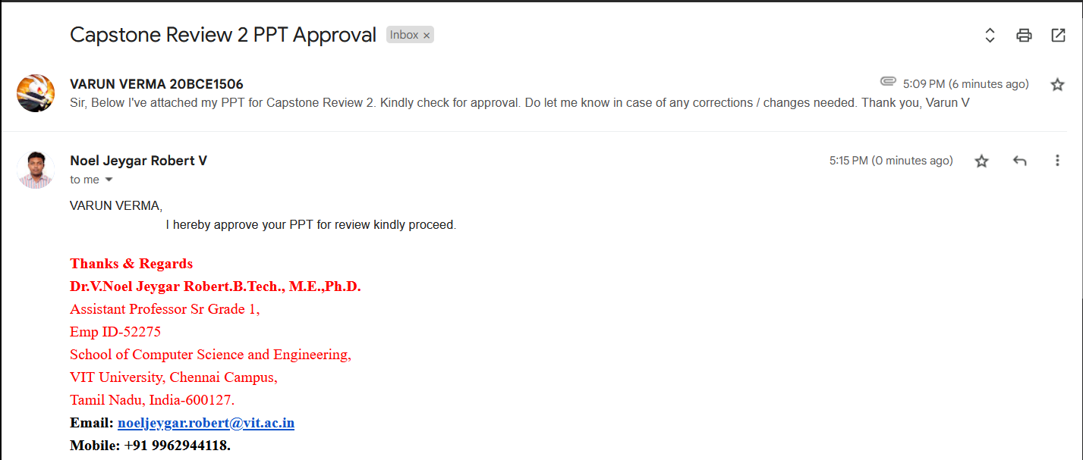
Guide Approval mail snapshot

Slide 34
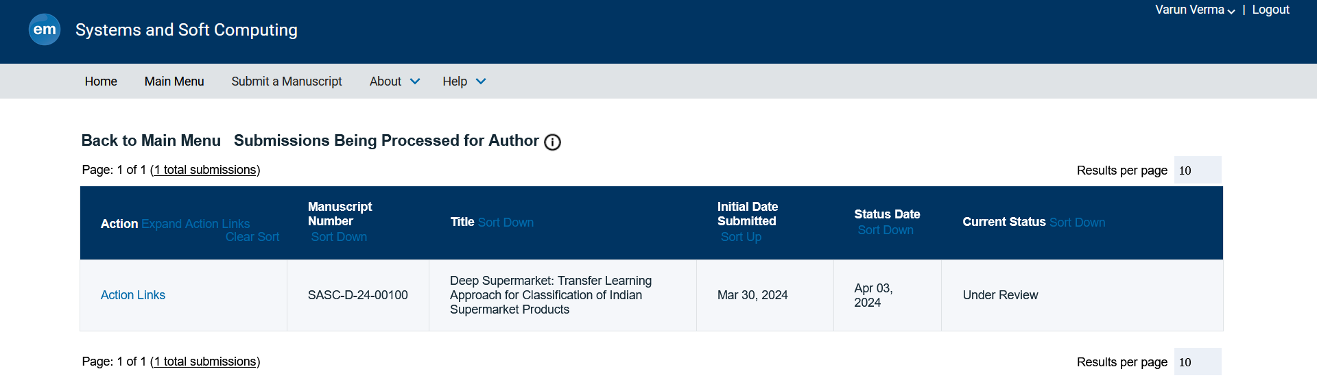
Research Paper Status

Slide 35
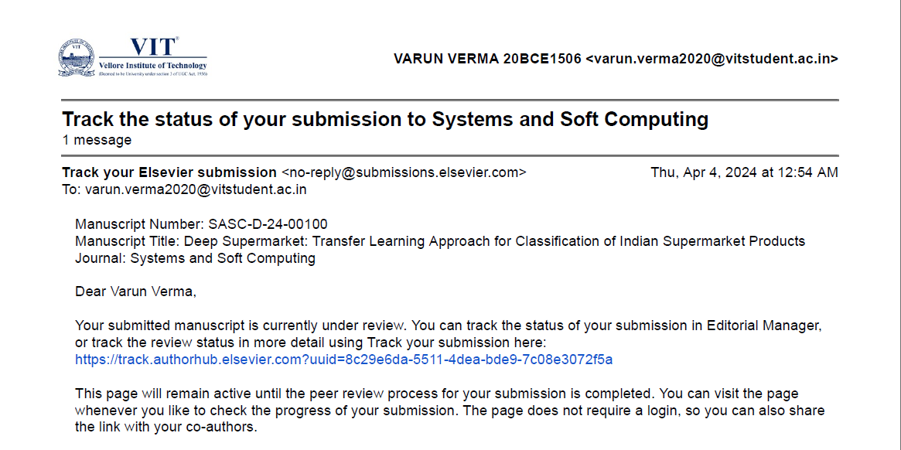
Research Paper Status

Slide 36
References
[0]Base Paper : Wiryana, Made & Harmanto, Suryadi & Fauzi, Alfharizky & Qisthi, Imam & Utami, Zalita. (2023). Store product classification using convolutional neural network. IAES International Journal of Artificial Intelligence (IJ-AI). 12. 1439. 10.11591/ijai.v12.i3.pp1439-1447.
Available : here
[1]Muhathir, M. F. Dwi Ryandra, R. B. Y. Syah, N. Khairina, and R. Muliono, “Convolutional Neural Network (CNN) of Resnet-50 with Inceptionv3 Architecture in Classification on X-Ray Image,” Convolutional Neural Network (CNN) of Resnet-50 with Inceptionv3 Architecture in Classification on X-Ray Image | SpringerLink, Jul. 09, 2023. [Online]. Available: https://link.springer.com/chapter/10.1007/978-3-031-35314-7_20
[2]“An effective CNN and Transformer complementary network for medical image segmentation,” An effective CNN and Transformer complementary network for medical image segmentation - ScienceDirect, Nov. 30, 2022. [Online]. Available: https://www.sciencedirect.com/science/article/abs/pii/S0031320322007075
[3]“Comparison of CNN-based deep learning architectures for rice diseases classification,” Comparison of CNN-based deep learning architectures for rice diseases classification - ScienceDirect, Jul. 14, 2023. [Online]. Available: https://www.sciencedirect.com/science/article/pii/S2589721723000235
[4]S. E. Abdallah, W. M. Elmessery, M. Y. Shams, and N. S. A. Al-Sattary, “Deep Learning Model Based on ResNet-50 for Beef Quality Classification,” Arab Journals Platform, Oct. 08, 2022. [Online]. Available: https://digitalcommons.aaru.edu.jo/isl/vol12/iss1/24
[5]S. Kumar, S. Pal, V. P. Singh, and P. Jaiswal, “Performance evaluation of ResNet model for classification of tomato plant disease,” De Gruyter, Jan. 01, 2023. [Online]. Available: https://www.degruyter.com/document/doi/10.1515/em-2021-0044/html
[6]V. Anand, S. Gupta, A. Altameem, S. R. Nayak, R. C. Poonia, and A. K. Jilani Saudagar, “An Enhanced Transfer Learning Based Classification for Diagnosis of Skin Cancer,” MDPI, Jul. 05, 2022. [Online]. Available: https://www.mdpi.com/2075-4418/12/7/1628

Slide 37
[7]A. W. Salehi et al., “A Study of CNN and Transfer Learning in Medical Imaging: Advantages, Challenges, Future Scope,” MDPI, Mar. 29, 2023. [Online]. Available: https://www.mdpi.com/2071-1050/15/7/5930
[8]M. M. Srikantamurthy, V. P. Subramanyam Rallabandi, D. B. Dudekula, S. Natarajan, and J. Park, “Classification of benign and malignant subtypes of breast cancer histopathology imaging using hybrid CNN-LSTM based transfer learning - BMC Medical Imaging,” SpringerLink, Jan. 30, 2023. [Online]. Available: https://link.springer.com/article/10.1186/s12880-023-00964-0
[9]“Fusion of U-Net and CNN model for segmentation and classification of skin lesion from dermoscopy images,” Fusion of U-Net and CNN model for segmentation and classification of skin lesion from dermoscopy images - ScienceDirect, Nov. 09, 2022. [Online]. Available: https://www.sciencedirect.com/science/article/abs/pii/S0957417422022485
[10] A. Patra, V. Vivek, B. R. Shambhavi, K. Sindhu, and S. Balaji, “Product Classification in E-Commerce Sites,” Product Classification in E-Commerce Sites | SpringerLink, Apr. 16, 2021. [Online]. Available: https://link.springer.com/chapter/10.1007/978-981-33-4299-6_40
[11] A. Motwani, G. Bajaj, M. Arya, S. K. Sar, and S. O. Manoj, “Machine Learning-Based Autonomous Framework for Product Classification Over Cloud,” Machine Learning-Based Autonomous Framework for Product Classification Over Cloud | SpringerLink, May 31, 2023. [Online]. Available: https://link.springer.com/chapter/10.1007/978-981-19-9638-2_6
[12]M. I. Basheer Ahmed et al., “Deep Learning Approach to Recyclable Products Classification: Towards Sustainable Waste Management,” MDPI, Jul. 17, 2023. [Online]. Available: https://www.mdpi.com/2071-1050/15/14/11138
[13]“Convolutional Neural Network (CNN) Based Identification of Crop Diseases Using ResNet-50,” Convolutional Neural Network (CNN) Based Identification of Crop Diseases Using ResNet-50 | IEEE Conference Publication | IEEE Xplore. [Online]. Available: https://ieeexplore.ieee.org/abstract/document/10370122
[14] Kılıçarslan G, Koç C, Özyurt F, Gül Y. Breast lesion classification using features fusion and selection of ensemble ResNet method. Int J Imaging Syst Technol. 2023; 33(5): 1779-1795. doi:10.1002/ima.22894
[15] R. S. Sabeenian, Eldho Paul & C. Prakash (2023) Fabric defect detection and classification using modified VGG network, The Journal of The Textile Institute, 114:7, 1032-1040, DOI: 10.1080/00405000.2022.2105112
[16] Zheng, Yufeng & Yang, Clifford & Merkulov, Aleksey. (2018). Breast cancer screening using convolutional neural network and follow-up digital mammography. 4. 10.1117/12.2304564.
[17] Khalil, Muhammad & Tehsin, Samabia & Humayun, Mamoona & Jhanjhi, Noor & AlZain, Mohammed. (2022). Multi-Scale Network for Thoracic Organs Segmentation. Computers, Materials and Continua. 70. 3251-3265. 10.32604/cmc.2022.020561.
[18] Tan, M., & Le, Q. (2019, May). Efficientnet: Rethinking model scaling for convolutional neural networks. In International conference on machine learning (pp. 6105-6114). PMLR.
[19] Szegedy, C., Ioffe, S., Vanhoucke, V., & Alemi, A. (2017, February). Inception-v4, inception-resnet and the impact of residual connections on learning. In Proceedings of the AAAI conference on artificial intelligence (Vol. 31, No. 1).

Slide 38
Poster

